Slide 1
Power Iteration Clustering
Frank Lin
10-710 Structured Prediction
School of Computer Science
Carnegie Mellon University
2011-11-28

Slide 2
Talk Outline
Clustering
Spectral Clustering
Power Iteration Clustering (PIC)
  PIC with Path Folding
  PIC Extensions

Slide 3
Clustering
Automatic grouping of data points
3 example datasets:

Slide 4
k-means
A well-known clustering method
  Given: Points in Euclidean space and an integer k
  Find: k clusters determined by k centroids
  Objective: Minimize within-cluster sum of square distances
☺
☹
☹

Slide 5
Graph Clustering
Given: Data = Network
= Graph = Matrix
C
 | A | B | C | D | E | F | G | H | I | J
A |  | 1 |  | 1 |  | 1
B | 1 |  | 1
C |  | 1
D | 1 |  |  |  |  | 1
E |  |  |  |  |  | 1
F | 1 |  |  | 1 | 1
G |  |  |  |  |  |  |  |  | 1
H |  |  |  |  |  |  |  |  | 1 | 1
I |  |  |  |  |  |  | 1 | 1 |  | 1
J |  |  |  |  |  |  |  | 1 | 1
G
A
I
B
H
J
F
D
E

Slide 6

Graph Clustering
Example - Normalized Cut:
Find: Partitions of the graph
Objective: Minimizes (or maximizes) an objective function according to a certain definition of a “balanced cut”
C
 | A | B | C | D | E | F | G | H | I | J
A |  | 1 |  | 1 |  | 1 |  |  | 1
B | 1 |  | 1
C |  | 1
D | 1 |  |  |  |  | 1
E |  |  |  |  |  | 1
F | 1 |  |  | 1 | 1
G |  |  |  |  |  |  |  |  | 1
H |  |  |  |  |  |  |  |  | 1 | 1
I | 1 |  |  |  |  |  | 1 | 1 |  | 1
J |  |  |  |  |  |  |  | 1 | 1
G
A
I
B
Exact Solution is NP-hard!
H
J
F
D
E

Slide 7
Talk Outline
Clustering
Spectral Clustering
Power Iteration Clustering (PIC)
  PIC with Path Folding
  PIC Extensions

Slide 8
Spectral Clustering
Relax solution
to take on real values, then compute via eigencomputation
Does two things:
  Provides good polynomial-time approximation to the balanced graph cut problem
  Clustering according to similarity, not Euclidean space
Recall that similarity can be represented as a graph/matrix

Slide 9
Spectral Clustering
How: Cluster data points in the space spanned by the “significant” eigenvectors (spectrum) of a [Laplacian] similarity matrix
A popular spectral clustering method: normalized cuts (NCut)
Notes:
Details, don’t worry

Slide 10
Spectral Clustering
Results with Normalized Cuts:
☺
☺
☺

Slide 11
Spectral Clustering
dataset and normalized cut results
cluster
1
2
3
clustering space
2nd smallest eigenvector
value
index
3rd smallest eigenvector

Slide 12
Spectral Clustering
Can we find a similar low-dimensional embedding for clustering without eigenvectors?
Finding eigenvectors and eigenvalues of a matrix is still pretty slow in general
Normalized Cut algorithm (Shi & Malik 2000):
  Choose k and similarity function s
  Derive A from s, let W=I-D⁻¹A, where I is the identity matrix and D is a diagonal square matrix D_{ii}=Σ_{j} A_{ij}
  Find eigenvectors and corresponding eigenvalues of W
  Pick the k eigenvectors of W with the 2nd to k^{th} smallest corresponding eigenvalues as “significant” eigenvectors
  Project the data points onto the space spanned by these vectors
  Run k-means on the projected data points

Slide 13
Talk Outline
Clustering
Spectral Clustering
Power Iteration Clustering (PIC)
  PIC with Path Folding
  PIC Extensions

Slide 14
Power Iteration Clustering
Spectral clustering methods are nice, and a natural choice for graph data
But they are rather expensive and slow
Power iteration clustering (PIC) can provide a similar solution at a very low cost (fast)!

Slide 15
The Power Iteration
Or the power method, is a simple iterative method for finding the dominant eigenvector of a matrix:
Typically converges quickly; fairly efficient if W is a sparse matrix
v^{t} : the vector at iteration t;
v⁰ typically a random vector
c : a normalizing constant to keep v^{t} from getting too large or too small
W : a square matrix

Slide 16
The Power Iteration
Or the power method, is a simple iterative method for finding the dominant eigenvector of a matrix:
Row-normalized similarity matrix
What if we let W=D⁻¹A
(like Normalized Cut)?
Notes:
Details:.....

Slide 17
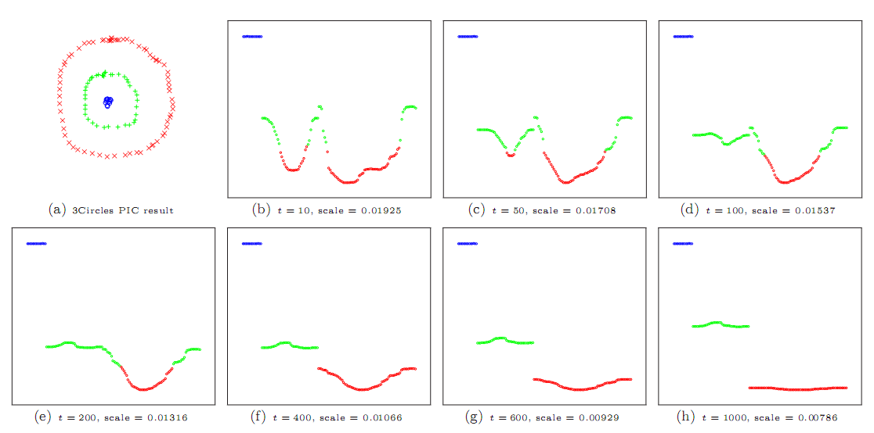
The Power Iteration

Slide 18
Power Iteration Clustering
The 2nd to k^{th} eigenvectors of W=D⁻¹A are roughly piece-wise constant with respect to the underlying clusters, each separating a cluster from the rest of the data
The linear combination of piece-wise constant vectors is also piece-wise constant!

Slide 19
Spectral Clustering
dataset and normalized cut results
cluster
1
2
3
clustering space
2nd smallest eigenvector
value
index
3rd smallest eigenvector

Slide 20
a·
+
b·
=

Slide 21
Power Iteration Clustering
dataset and PIC results
Key idea: to do clustering, we may not need all the information in a full spectral embedding (e.g., distance between clusters in a k-dimension eigenspace)
v^{t}
we just need the clusters to be separated in some space.

Slide 22
When to Stop
Details
Recall:
At the beginning, v changes fast (“accelerating”) to converge locally due to “noise terms” (k+1…n) with small λ
Then:
When “noise terms” have gone to zero, v changes slowly (“constant speed”) because only larger λ terms (2…k) are left, where the eigenvalue ratios are close to 1
Because they are raised to the power t, the eigenvalue ratios determines how fast v converges to e₁

Slide 23
Power Iteration Clustering
A basic power iteration clustering (PIC) algorithm:
Input: A row-normalized affinity matrix W and the number of clusters k
Output: Clusters C₁, C₂, …, C_{k}
Pick an initial vector v⁰
Repeat
  Set v^{t+1} ← Wv^{t}
  Set δ^{t+1} ← |v^{t+1} – v^{t}|
  Increment t
  Stop when |δ^{t} – δ^{t-1}| ≈ 0
Use k-means to cluster points on v^{t} and return clusters C₁, C₂, …, C_{k}
i.e., when acceleration is nearly zero
Notes:
Acceleration stops

Slide 24
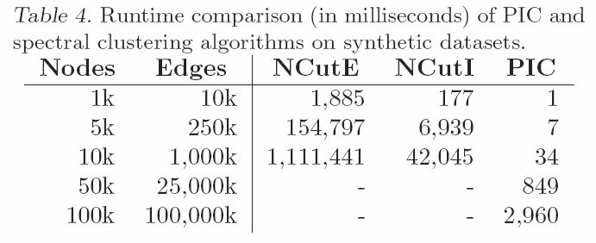
PIC Runtime
Normalized Cut
Normalized Cut, faster implementation
Ran out of memory (24GB)

Slide 25
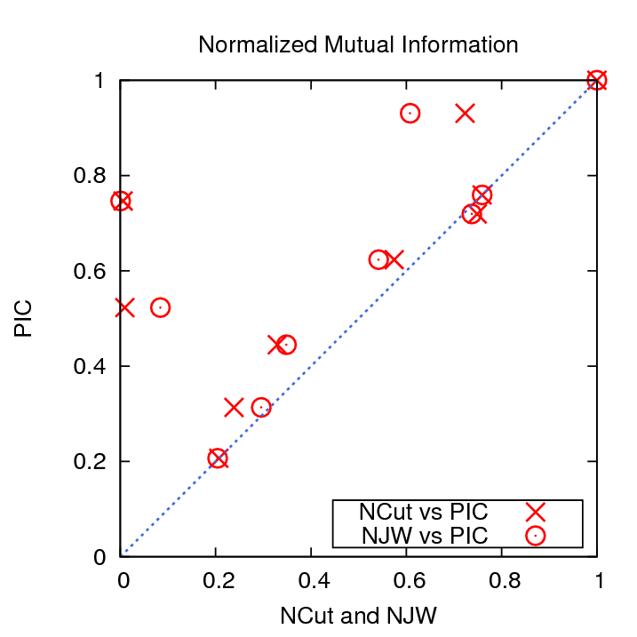
PIC Accuracy on Network Datasets
Upper triangle: PIC does better
Lower triangle: NCut or NJW does better

Slide 26
Talk Outline
Clustering
Spectral Clustering
Power Iteration Clustering (PIC)
  PIC with Path Folding
  PIC Extensions

Slide 27
Clustering Text Data
Spectral clustering methods are nice
We want to use them for clustering text data
(A lot of)

Slide 28
The Problem with Text Data
Documents are often represented as feature vectors of words:
The importance of a Web page is an inherently subjective matter, which depends on the readers…
In this paper, we present Google, a prototype of a large-scale search engine which makes heavy use…
You're not cool just because you have a lot of followers on twitter, get over yourself…
cool | web | search | make | over | you
0 | 4 | 8 | 2 | 5 | 3
0 | 8 | 7 | 4 | 3 | 2
1 | 0 | 0 | 0 | 1 | 2

Slide 29
The Problem with Text Data
Feature vectors are often sparse
But similarity matrix is not!
Mostly non-zero - any two documents are likely to have a word in common
Mostly zeros - any document contains only a small fraction of the vocabulary
 | 27 | 125 | -
 | 23 | - | 125
 | - | 23 | 27
cool | web | search | make | over | you
0 | 4 | 8 | 2 | 5 | 3
0 | 8 | 7 | 4 | 3 | 2
1 | 0 | 0 | 0 | 1 | 2

Slide 30
The Problem with Text Data
In general O(n³); approximation methods still not very fast
A similarity matrix is the input to many clustering methods, including spectral clustering
Spectral clustering requires the computation of the eigenvectors of a similarity matrix of the data
Too expensive! Does not scale up to big datasets!
O(n²) time to construct
 | 27 | 125 | -
 | 23 | - | 125
 | - | 23 | 27
O(n²) space to store
> O(n²) time to operate on

Slide 31
The Problem with Text Data
We want to use the similarity matrix for clustering (like spectral clustering), but:
  Without calculating eigenvectors
  Without constructing or storing the similarity matrix
Power Iteration Clustering
+ Path Folding
Notes:
Ask question: what should we do?

Slide 32
Path Folding
Okay, we have a fast clustering method – but there’s the W that requires O(n²) storage space and construction and operation time!
A basic power iteration clustering (PIC) algorithm:
Input: A row-normalized affinity matrix W and the number of clusters k
Output: Clusters C₁, C₂, …, C_{k}
Pick an initial vector v⁰
Repeat
  Set v^{t+1} ← Wv^{t}
  Set δ^{t+1} ← |v^{t+1} – v^{t}|
  Increment t
  Stop when |δ^{t} – δ^{t-1}| ≈ 0
Use k-means to cluster points on v^{t} and return clusters C₁, C₂, …, C_{k}
Key operation in PIC
Note: matrix-vector multiplication!

Slide 33
Path Folding
How could this be better?
What’s so good about matrix-vector multiplication?
If we can decompose the matrix…
Then we arrive at the same solution doing a series of matrix-vector multiplications!
Notes:
Boxes under W, A, B, C

Slide 34
Path Folding
As long as we can decompose the matrix into a series of sparse matrices, we can turn a dense matrix-vector multiplication into a series of sparse matrix-vector multiplications.
This is exactly the case for text data
This means that we can turn an operation that requires O(n²) storage and runtime into one that requires ~O(n) storage and runtime!
And many other kinds of data as well!
Notes:
Order of ~O(n) non-zero

Slide 35
Path Folding
Details
Example – inner product similarity:
Why is it ~n and not n?
Diagonal matrix that normalizes W so rows sum to 1
The original feature matrix
The feature matrix transposed
Storage: ~n
Construction: given
Storage: ~O(n)
Construction: given
Storage: just use F
Notes:
Do the boxes!

Slide 36
Path Folding
Okay…how about a similarity function we actually use for text data?
Details
Example – inner product similarity:
Construction: ~O(n)
Storage:
~O(n)
Operation: ~O(n)
Iteration update:
Notes:
~O(n)

Slide 37
Path Folding
Details
Diagonal cosine normalizing matrix
Example – cosine similarity:
Construction: ~O(n)
Storage:
~O(n)
Operation: ~O(n)
Iteration update:
Compact storage: we don’t need a cosine-normalized version of the feature vectors
Notes:
~O(n): explain length assumption
Cosine similarity – 5 or 6 lectures down the road

Slide 38
Path Folding
We refer to this technique as path folding due to its connections to “folding” a bipartite graph into a unipartite graph.

Slide 39
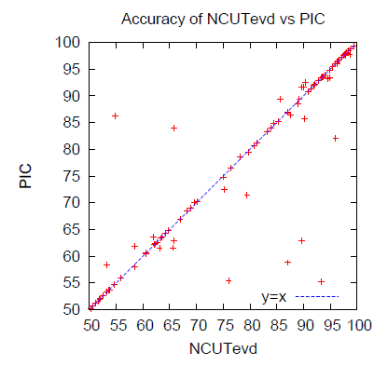
Results
Diagonal: tied (most datasets)
An accuracy result:
Upper triangle: we win
Each point is accuracy for a 2-cluster text dataset
Lower triangle: spectral clustering wins

Slide 40
Talk Outline
Clustering
Spectral Clustering
Power Iteration Clustering (PIC)
  PIC with Path Folding
  PIC Extensions

Slide 41
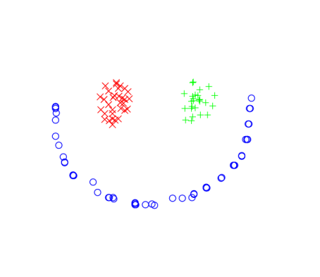



PIC Extension: Avoiding Collisions
One robustness question for vanilla PIC as data size and complexity grows:
How many (noisy) clusters can you fit in one dimension without them “colliding”?
Cluster signals cleanly separated
A little too close for comfort?

Slide 42
PIC Extension: Avoiding Collisions
A solution:
  Run PIC d times with different random starts and construct a d-dimension embedding
    Unlikely two clusters collide on all d dimensions
    We can afford it because PIC is fast and space-efficient!

Slide 43
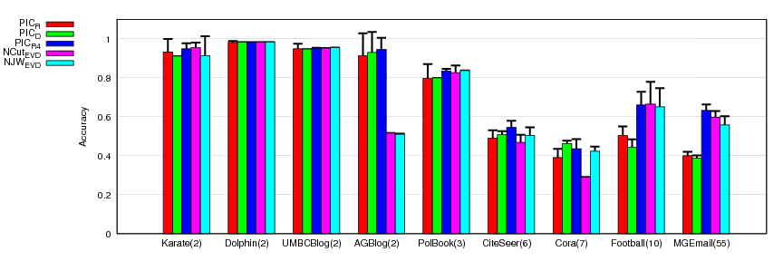
PIC Extension: Avoiding Collisions
Preliminary results on network classification datasets:
1-dimension PIC embeddings lose on accuracy at higher k’s compared to NCut and NJW
RED: PIC embedding with a random start vector
GREEN: PIC using a degree start vector
BLUE: PIC using 4 random start vectors
Dataset (k)
But using a 4 random vectors instead helps!
Note # of vectors << k
# of clusters

Slide 44
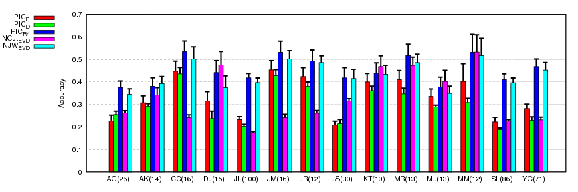
PIC Extension: Avoiding Collisions
Preliminary results on name disambiguation datasets:
Again using a 4 random vectors seems to work!
Again note # of vectors << k

Slide 45
PIC Extension: Avoiding Collisions
2-dimensional embedding of Football dataset:
Each circle is a college embedded in 2d space. Colors correspond to football conferences
Notice how “collisions” in a single dimension is resolved!
Y-axis position determined by another PIC vector with random start
X-axis position determined by a PIC vector with random start

Slide 46
PIC Extension: Hierarchical Clustering
Real, large-scale data may not have a “flat” clustering structure
A hierarchical view may be more useful
Good News:
The dynamics of a PIC embedding display a hierarchically convergent behavior!

Slide 47
PIC Extension: Hierarchical Clustering
Details
Why?
Recall PIC embedding at time t:
e’s – eigenvectors (structure)
Big
Small
More salient structure stick around
There may not be a clear eigengap - a gradient of cluster saliency
Less significant eigenvectors / structures go away first, one by one

Slide 48




PIC Extension: Hierarchical Clustering
Similar behavior also noted in matrix-matrix power methods (diffusion maps, mean-shift, multi-resolution spectral clustering)
Same dataset you’ve seen
PIC already converged to 8 clusters…
But let’s keep on iterating…
“N” still a part of the “2009” cluster…
Yes!
(it might take a while)

Slide 49
Questions & Discussion
For further information, questions, and discussion:
  http://www.cs.cmu.edu/~frank
  frank@cs.cmu.edu
  GHC 5507
Notes:
Contact & email address

Slide 50
Additional Information

Slide 51
PIC: Related Clustering Work
Spectral Clustering
  (Roxborough & Sen 1997, Shi & Malik 2000, Meila & Shi 2001, Ng et al. 2002)
Kernel k-Means (Dhillon et al. 2007)
Modularity Clustering (Newman 2006)
Matrix Powering
  Markovian relaxation & the information bottleneck method (Tishby & Slonim 2000)
  matrix powering (Zhou & Woodruff 2004)
  diffusion maps (Lafon & Lee 2006)
  Gaussian blurring mean-shift (Carreira-Perpinan 2006)
Mean-Shift Clustering
  mean-shift (Fukunaga & Hostetler 1975, Cheng 1995, Comaniciu & Meer 2002)
  Gaussian blurring mean-shift (Carreira-Perpinan 2006)

Slide 52
PIC: Some “Powering” Methods at a Glance
Method | W | Iterate | Stopping | Final
Tishby & Slonim 2000 | W=D⁻¹A | W^{t+1}=W^{t} | rate of information loss | information bottleneck method
Zhou & Woodruff 2004 | W=A | W^{t+1}=W^{t} | a small t | a threshold ε
Carreira-Perpinan 2006 | W=D⁻¹A | X^{t+1}=WX | entropy | a threshold ε
PIC | W=D⁻¹A | v^{t+1}=Wv^{t} | acceleration | k-means
How far can we go with a one- or low-dimensional embedding?

Slide 53
PIC: Versus Popular Fast Sparse Eigencomputation Methods
Randomized sampling methods are also popular
For Symmetric Matrices | For General Matrices | Improvement
 | Successive Power Method | Basic; numerically unstable, can be slow
Lanczos Method | Arnoldi Method | More stable, but may require lots of time and memory
Implicitly Restarted Lanczos Method (IRLM) | Implicitly Restarted Arnoldi Method (IRAM) | More time- and memory-efficient
n = # nodes
e = # edges
k =
# eigenvectors
m (>k) =
Arnoldi Length
Method | Time | Space
IRAM | (O(m³)+(O(nm)+O(e))×O(m-k))×(# restart) | O(e)+O(nm)
PIC | O(e)x(# iterations) | O(e)

Slide 54
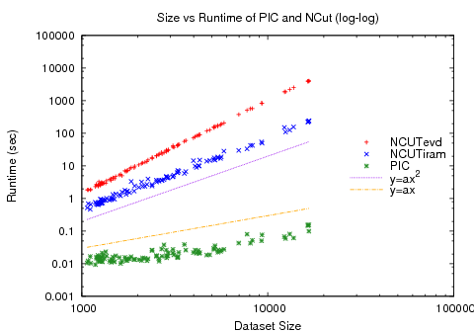
PICwPF: Results
y: algorithm runtime (log scale)
Spectral clustering (red & blue)
A scalability result:
Quadratic curve
Linear curve
x: data size (log scale)
Our method (green)

Slide 55
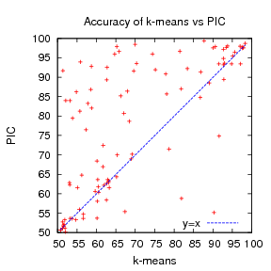
PICwPF: Results
Upper triangle: PIC wins
Each point represents the accuracy result from a dataset
Lower triangle: k-means wins

Slide 56
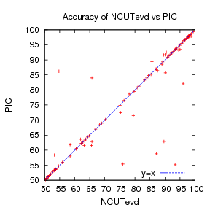
PICwPF: Results
Two methods have almost the same behavior
Overall, one method not statistically significantly better than the other

Slide 57
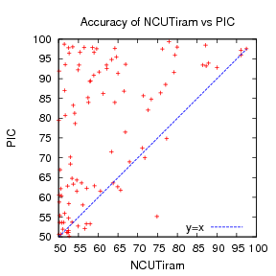
PICwPF: Results
Lesson: Approximate eigen- computation methods may require expertise to work well
Not sure why NCUTiram did not work as well as NCUTevd

Slide 58
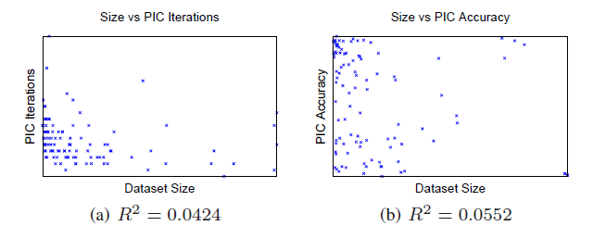
PICwPF: Results
PIC is O(n) per iteration and the runtime curve looks linear…
But I don’t like eyeballing curves, and perhaps the number of iteration increases with size or difficulty of the dataset?
Correlation plot
Correlation statistic
(0=none, 1=correlated)

Slide 59
PICwPF: Results
Linear run-time implies constant number of iterations.
Number of iterations to “acceleration-convergence” is hard to analyze:
  Faster than a single complete run of power iteration to convergence.
  On our datasets
    10-20 iterations is typical
    30-35 is exceptional

Slide 60
PICwPF: Related Work
Not O(n) time methods
Faster spectral clustering
  Approximate eigendecomposition (Lanczos, IRAM)
  Sampled eigendecomposition (Nyström)
Sparser matrix
  Sparse construction
    k-nearest-neighbor graph
    k-matching
  graph sampling / reduction
Still require O(n²) construction in general
Not O(n) space methods

Slide 61
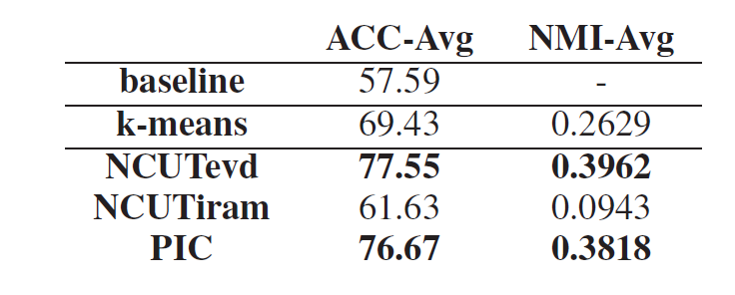
PICwPF: Results

