Slide 1



From Tweets to Polls:
Linking Text Sentiment to Public Opinion Time Series
Brendan O’Connor
Ramnath Balasubramanyan
Bryan R. Routledge
Noah A. Smith
Carnegie Mellon University

Slide 2

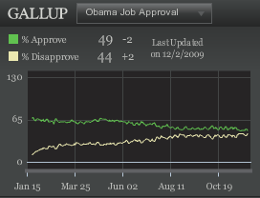
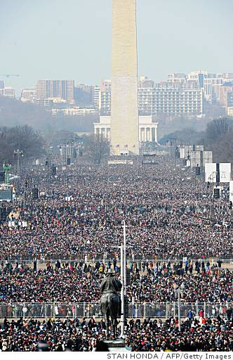

Measuring public opinion through social media?
People in U.S.
Query
I like Obama
Can we derive a
similar measurement?
I do not
Aggregate
Text Sentiment Measure
Query
Write

Slide 3
Contributions
Correlations between
  Very simple text sentiment analysis
  Telephone public opinion polls
    Consumer confidence and Presidential job approval
Time-series smoothing is a critical issue
Also
  Topic selection, topic volumes, text leads polls, stemming, election polling

Slide 4
Rest of talk
Data Overview
Analysis
Discussion and Related Work
New Results!

Slide 5
Text Data: Twitter
Twitter is large, public, and all in one place
Sources
  Archiving Twitter Streaming API
    “Gardenhose”/”Sample”: ~15% of public tweets
  Scrape of earlier messages via API
  thanks to Brendan Meeder
Sizes
  0.7 billion messages, Jan 2008 – Oct 2009
  1.5 billion messages, Jan 2008 – May 2010

Slide 6
Message data
{
"text": "Time for the States to fight back !!! Tenth Amendment Movement: Taking On the Feds http://bit.ly/14t1RV #tcot #teaparty”,
"created_at": "Tue Nov 17 21:08:39 +0000 2009",
"geo": null,
"id": 5806348114,
"in_reply_to_screen_name": null,
"in_reply_to_status_id": null,
"user": {
"screen_name": "TPO_News",
"created_at": "Fri May 15 04:16:38 +0000 2009",
"description": "Child of God - Married - Gun carrying NRA Conservative - Right Winger hard Core Anti Obama (Pro America), Parrothead - www.ABoldStepBack.com #tcot #nra #iPhone",
"followers_count": 10470,
"friends_count": 11328,
"name": "Tom O'Halloran",
"profile_background_color": "f2f5f5",
"profile_image_url": "http://a3.twimg.com/profile_images/295981637/TPO_Balcony_normal.jpg",
"protected": false,
"statuses_count": 21147,
"location": "Las Vegas, Baby!!",
"time_zone": "Pacific Time (US & Canada)",
"url": "http://www.tpo.net/1dollar",
"utc_offset": -28800,
}
}
Reply/Forward graphs!
Social graphs!
Images!
(Noisy) location info!

Slide 7
Message data we use
{
"text": "Time for the States to fight back !!! Tenth Amendment Movement: Taking On the Feds http://bit.ly/14t1RV #tcot #teaparty”,
"created_at": "Tue Nov 17 21:08:39 +0000 2009",
"geo": null,
"id": 5806348114,
"in_reply_to_screen_name": null,
"in_reply_to_status_id": null,
"user": {
"screen_name": "TPO_News",
"created_at": "Fri May 15 04:16:38 +0000 2009",
"description": "Child of God - Married - Gun carrying NRA Conservative - Right Winger hard Core Anti Obama (Pro America), Parrothead - www.ABoldStepBack.com #tcot #nra #iPhone",
"followers_count": 10470,
"friends_count": 11328,
"name": "Tom O'Halloran",
"profile_background_color": "f2f5f5",
"profile_image_url": "http://a3.twimg.com/profile_images/295981637/TPO_Balcony_normal.jpg",
"protected": false,
"statuses_count": 21147,
"location": "Las Vegas, Baby!!",
"time_zone": "Pacific Time (US & Canada)",
"url": "http://www.tpo.net/1dollar",
"utc_offset": -28800,
}
}
Text
Timestamp

Slide 8
Poll Data
Consumer confidence, 2008-2009
  Index of Consumer Sentiment (Reuters/Michigan)
  Gallup Daily (free version from gallup.com)
2008 Presidential Elections
  Aggregation, Pollster.com
2009 Presidential Job Approval
  Gallup Daily
Which tweets correspond to these polls?

Slide 9
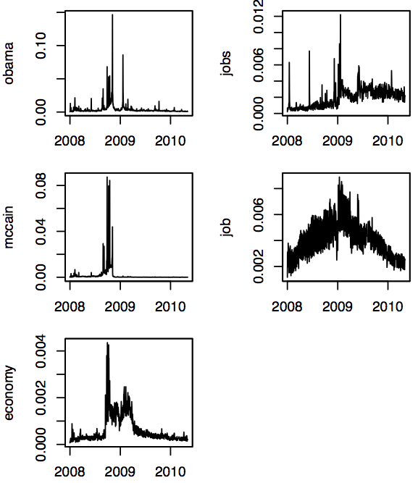
Message selection via topic keywords
Analyzed subsets of messages that contained manually selected topic keyword
  “economy”, “jobs”, “job”
  “obama”
  “obama”, “mccain”
High day-to-day volatility
  Fraction of messages containing keyword
  Nov 5 2008: 15% contain “obama”
Notes:
Nov 5 2008, “obama” volume is 14.6%, but median obama volume is 0.3%

Slide 10
Sentiment analysis: word counting
Subjectivity Clues lexicon from OpinionFinder / U Pitt
  Wilson et al 2005
  2000 positive, 3600 negative words
Procedure
  Within topical messages,
  Count messages containing these positive and negative words

Slide 11
A note on the sentiment list
This list is not well suited for social media English.
  “sucks”, “ :) ”, “ :( ”
Examples for one day.
(Top examples)
word valence count
will positive 3934
bad negative 3402
good positive 2655
help positive 1971
(Random examples)
word valence count
funny positive 114
fantastic positive 37
cornerstone positive 2
slump negative 85
bearish negative 17
crackdown negative 5

Slide 12
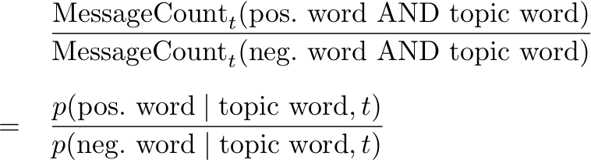
Sentiment Ratio over Messages
For one day t and topic word, compute score

Slide 13
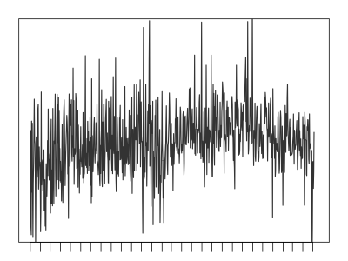

Sentiment Ratio Moving Average
High day-to-day volatility.
Average last k days.
Keyword “jobs”,
k = 1, 7, 30
(Gallup tracking polls: 3 or 7-day smoothing)

Slide 14
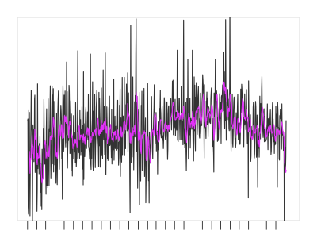
Sentiment Ratio Moving Average
High day-to-day volatility.
Average last k days.
Keyword “jobs”,
k = 1, 7, 30
(Gallup tracking polls: 3 or 7-day smoothing)

Slide 15

Sentiment Ratio Moving Average
High day-to-day volatility.
Average last k days.
Keyword “jobs”,
k = 1, 7, 30
(Gallup tracking polls: 3 or 7-day smoothing)

Slide 16
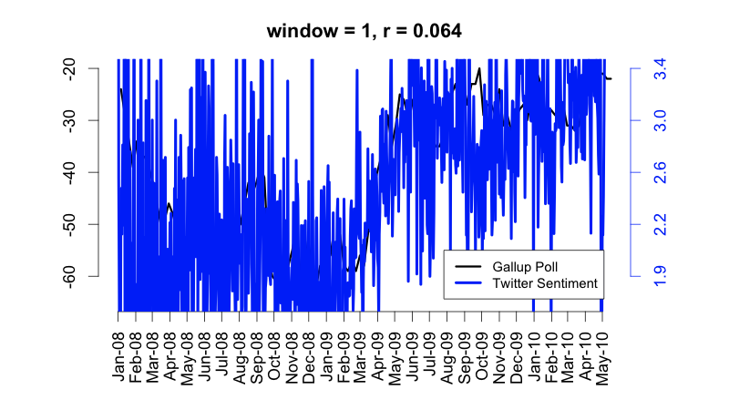
Smoothed comparisons
“jobs” sentiment

Slide 17
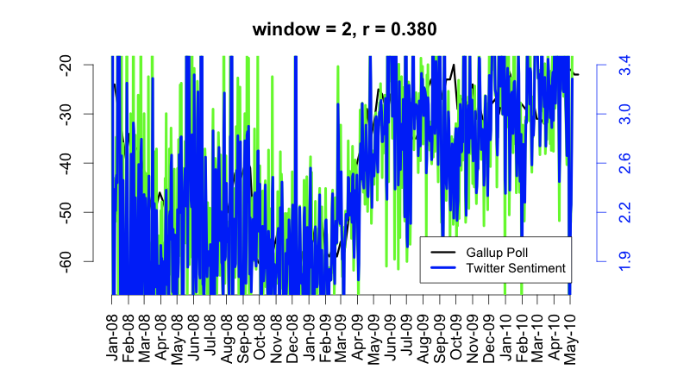
Smoothed comparisons
“jobs” sentiment

Slide 18
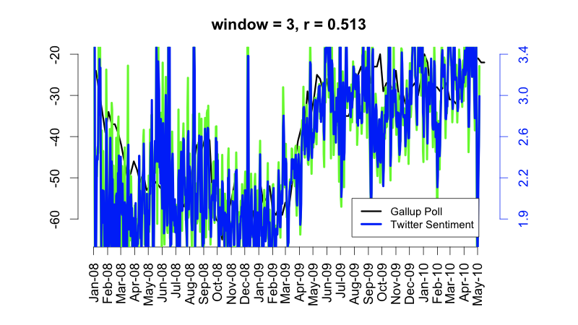
Smoothed comparisons
“jobs” sentiment

Slide 19
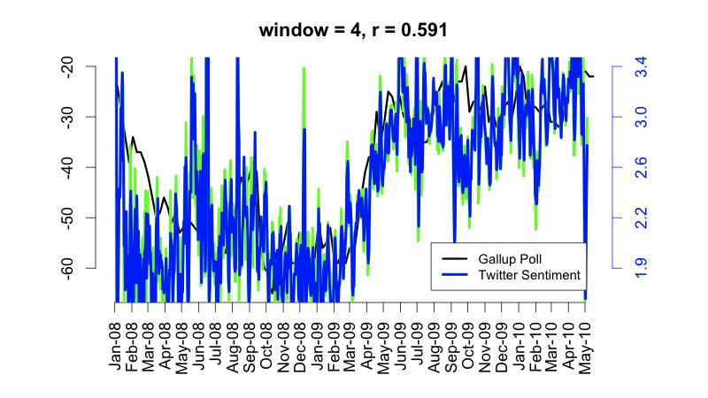
Smoothed comparisons
“jobs” sentiment

Slide 20
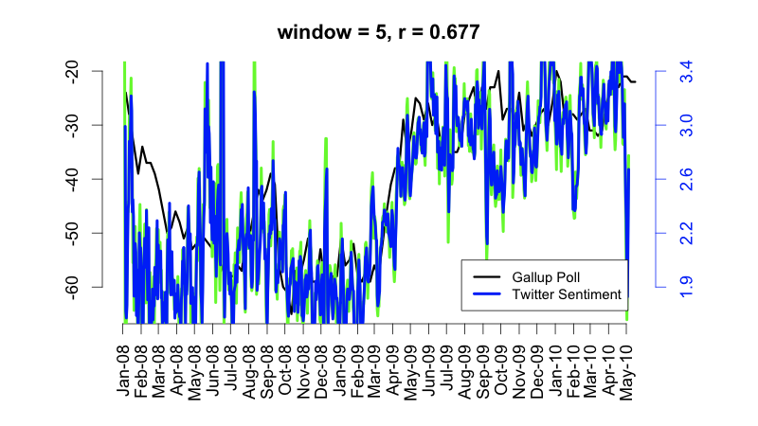
Smoothed comparisons
“jobs” sentiment

Slide 21
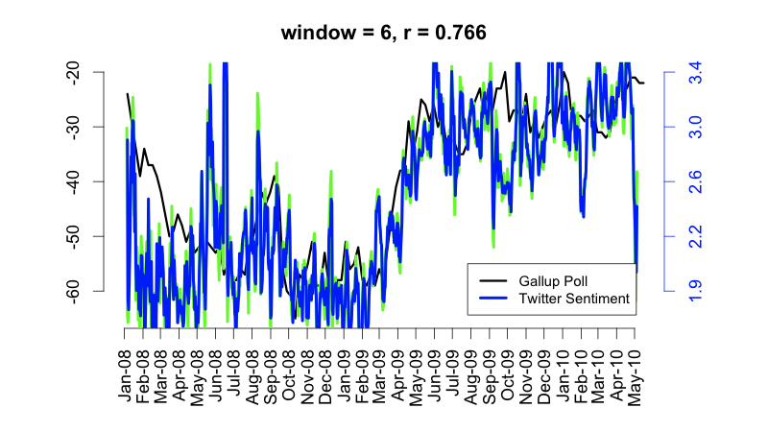
Smoothed comparisons
“jobs” sentiment

Slide 22
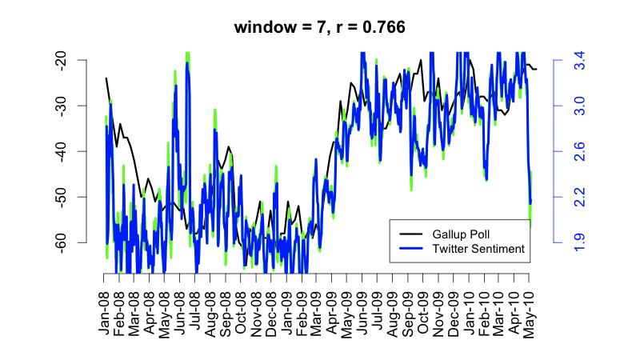
Smoothed comparisons
“jobs” sentiment

Slide 23
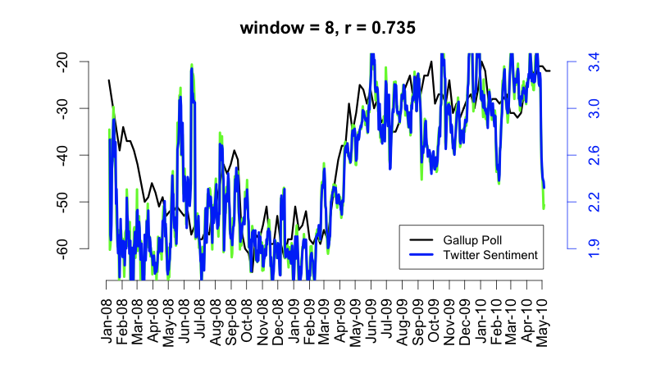
Smoothed comparisons
“jobs” sentiment

Slide 24
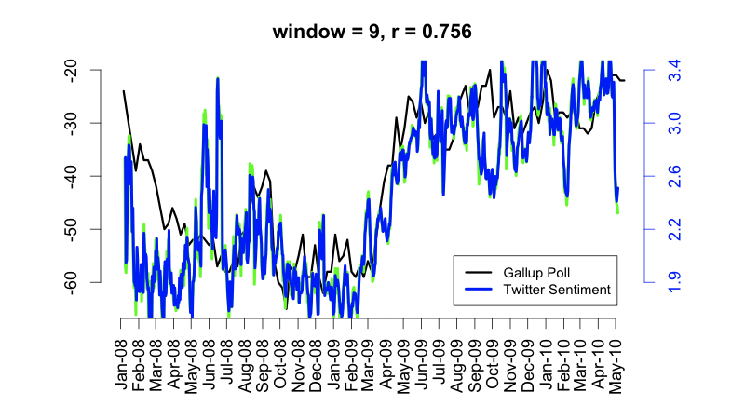
Smoothed comparisons
“jobs” sentiment

Slide 25

Smoothed comparisons
“jobs” sentiment

Slide 26

Smoothed comparisons
“jobs” sentiment

Slide 27
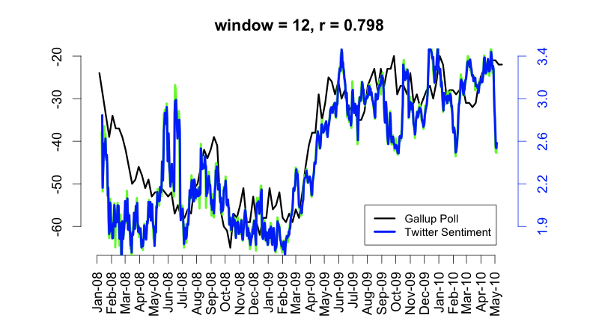
Smoothed comparisons
“jobs” sentiment

Slide 28

Smoothed comparisons
“jobs” sentiment

Slide 29
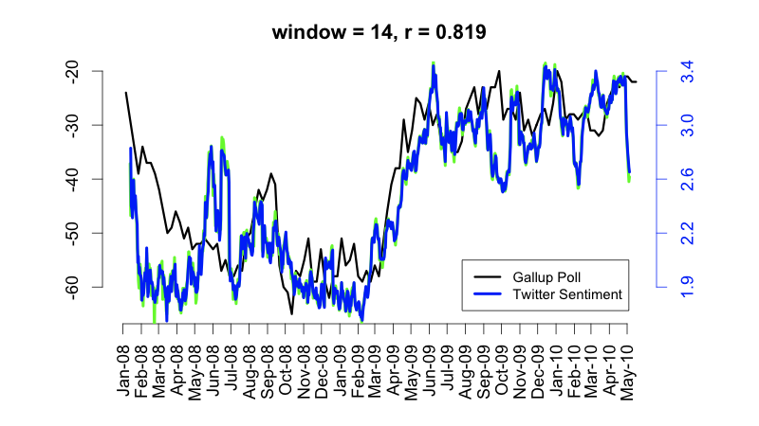
Smoothed comparisons
“jobs” sentiment

Slide 30
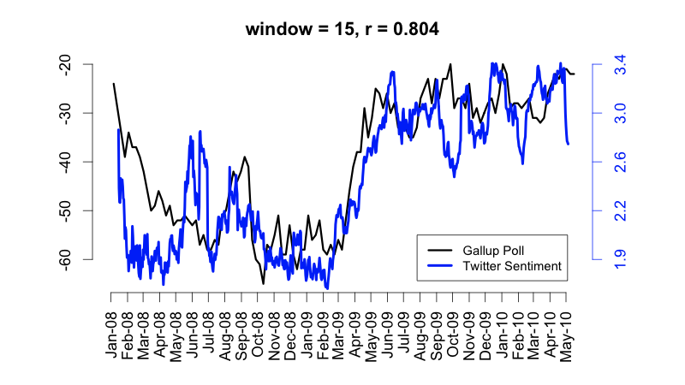
Smoothed comparisons
“jobs” sentiment

Slide 31
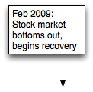
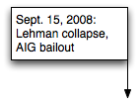
Smoothed comparisons
“jobs” sentiment

Slide 32
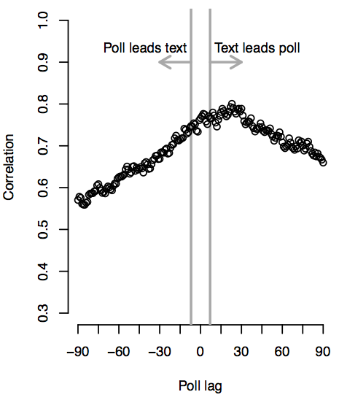
Which leads, poll or text?
Cross-correlation analysis: between
  Sentiment score for day t
  Poll for day t+L
“jobs” leading indicator for the poll
(Can turn into forecasting model: see paper)
Notes:
Peaks on right: text leads the poll.
Opinion estimation
Jobs news
This graph is 7-day smoothing for both text sentiment and gallup poll. (the weekly-rolled-up version from gallup as of may 23 2010. the version in the ppaer from december 2009 used 3-day rollups)

Slide 33
Keyword message selection
15-day windows, no lag
  “jobs” r = 80%
  “job” r = 7%
  “economy” r = -10%
Look out for stemming
  (“jobs” OR “job”) r = 40%
Notes:
Signal degrades

Slide 34
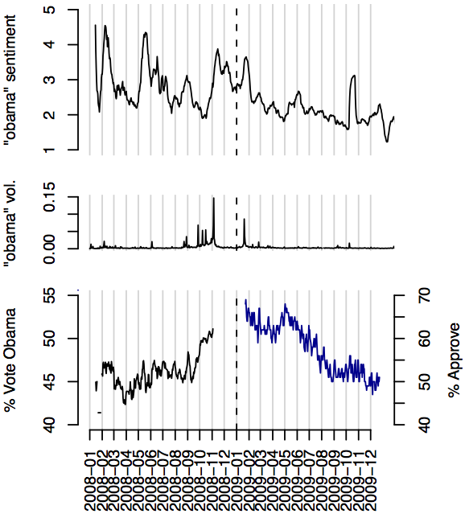
Presidential elections and job approval
2008 elections
  “obama” and “mccain” sentiment do not correlate
  But, “obama” and “mccain” volume => 79%, 74% (!)
  Simple indicator of election news?

Slide 35
Presidential elections and job approval
2008 elections
  “obama” and “mccain” sentiment do not correlate
  But, “obama” and “mccain” volume => 79%, 74% (!)
  Simple indicator of election news?
2009 job approval
  “obama” => r = 72%
  Looks easy: simple decline

Slide 36
Related work: aggregate sentiment
 | Text | Message Selection | Opinion Estimation | External Correlate
This work – O’Connor et al ICWSM-2010 | Microblogs (Twitter) | Keywords related to poll | Word counting (OpinionFinder) | Opinion polls
Mishne and de Rijke 2006 | Blogs (Livejournal) | N/A | Linear model (words, time) | Mood labels
Dodds and Danforth 2009 | Blogs, Speeches, Songs | N/A | Word counting (LIWC) | Exploratory (mostly)
Gilbert and Karahalios ICWSM-2010 | Blogs (Livejournal) | N/A | Decision tree + NB (words) | Stocks
Asur and Huberman 2010 | Microblogs (Twitter) | Movie name | NB-like model (char. n-grams) | Movie sales
Bollen et al 2010 | Microblogs (Twitter) | N/A | Word counting (POMS) | Stocks, politics
Tumasjan et al ICWSM-2010 | Microblogs (Twitter) | Party name | Word counting (POMS) | Elections
Kramer 2010 | Microblogs (Facebook Wall) | N/A | Word counting (LIWC) | Life satisfaction answers
… many more!

Slide 37
Conclusions
Preliminary results that sentiment analysis on Twitter data can give information similar to traditional opinion polls
  But, still not well-understood
  Twitter bias?
  News vs. opinion?
Issues
  Relevant message selection
  Time series smoothing
Replacement for polls?
Promising but not quite yet

